Slide 1
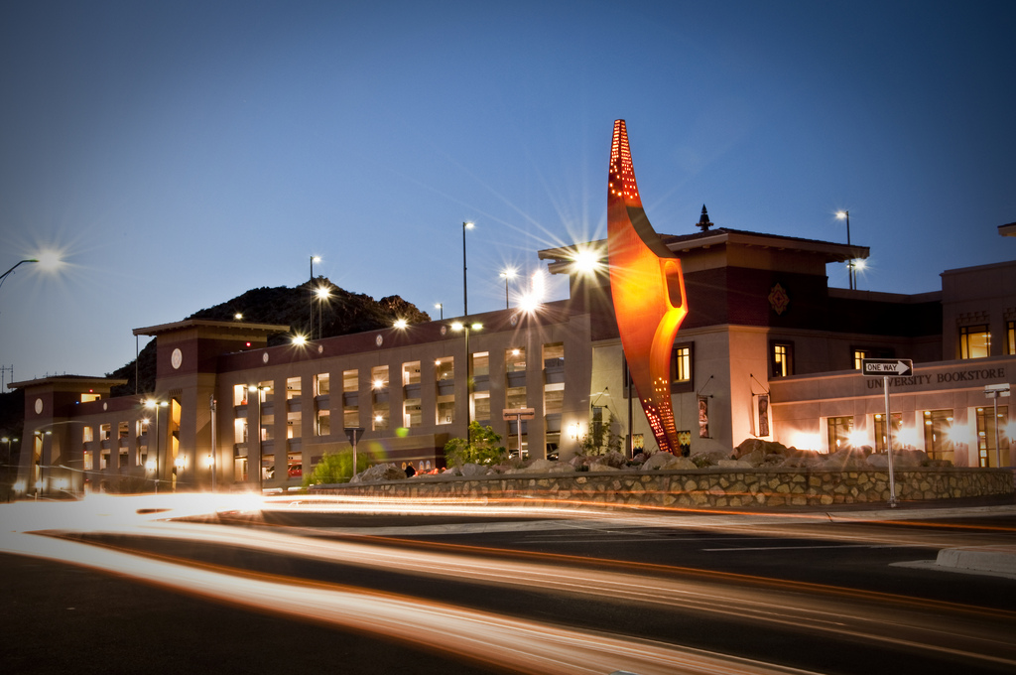
Community Engagement at UTEP Azuri Gonzalez Jenna Lujan José Villalobos

Slide 2
Fulfilling UTEP’s Mission through Community Engagement
“dedicated to the advancement of the El Paso region through interpretation, application and commercialization of key discoveries, and the dissemination of knowledge.”
“role as an intellectual, cultural and socioeconomic asset to the region, offering programs to meet human resource needs and contribute to the quality of life.”
“prepare students to make significant contributions to their professions, their communities and the world.”
“climate of scholarly inquiry, with a special focus on applying innovative interdisciplinary approaches to explore and address major issues that confront the multicultural, U.S.-Mexico border region.”

Slide 4
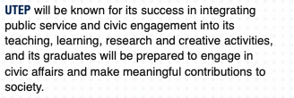
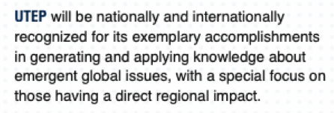

Slide 6
Fulfilling UTEP’s Mission through Community Engagement
“dedicated to the advancement of the El Paso region through interpretation, application and commercialization of key discoveries, and the dissemination of knowledge.”
“role as an intellectual, cultural and socioeconomic asset to the region, offering programs to meet human resource needs and contribute to the quality of life.”
“prepare students to make significant contributions to their professions, their communities and the world.”
“climate of scholarly inquiry, with a special focus on applying innovative interdisciplinary approaches to explore and address major issues that confront the multicultural, U.S.-Mexico border region.”

Slide 7
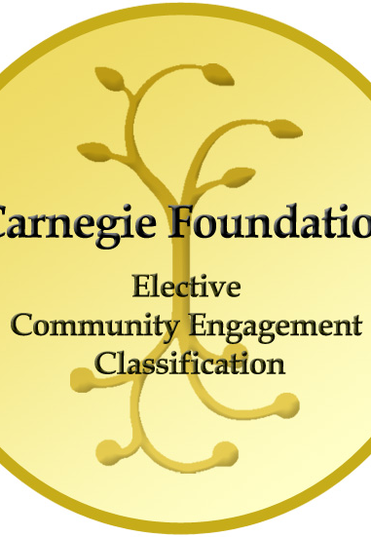
UTEP Community Engagement
Collaboration between institutions of higher education and their larger communities (local, regional/state, national, global) for the mutually beneficial exchange of knowledge and resources in context of partnership and reciprocity.

Slide 8
Community Engagement Purpose
enrich scholarship, research, and creative activity
enhance curriculum, teaching and learning
prepare educated, engaged citizens
strengthen democratic values and civic responsibility
address critical societal issues
contribute to the public good

Slide 9
Community Engagement Approaches and Models
Student
Faculty
Institutional

Slide 10
Student Community Engagement
Volunteerism
Community service
(professional included)
Academic based community engagement (service-learning)
Community-based internships/ practicum / clinical / student teaching
Consulting, project-based
Student community-based research

Slide 11
Faculty Community Engagement
RESEARCH
TEACHING
COMMUNITY
ENGAGED
SCHOLARSHIP
SERVICE

Slide 12
Faculty Community Engagement
Research
Teaching
Community-based research
Community based participatory research
Public research
Service learning
Practicum / clinical
Field based learning
Student research
Service
Volunteerism/Community service
Outreach
Service to profession
(capacity-building and mentoring for community engagement)

Slide 13
Community Engaged Scholarship
Community Engaged Scholarship(CES) is centered on a mutually-beneficial collaboration between the university and a community partner outside the academy. The purpose of the collaboration is to bring together the specialized knowledge of the university with the specialized knowledge of the community to generate new knowledge that contributes to the public good. CES meets the needs of the community partner as defined and expressed by the partner, with measurable outcomes. The collaborative work is characterized by robust participation by both the university and community partners and results are disseminated to all partners and beyond.

Slide 14
Community Engaged Scholarship
Scholarship of Discovery | Engaged Scholarship
Breaks new ground in the discipline | …and has direct application to broader public issues
Answers significant questions in the discipline | …which have relevance to public or community issues.
Is reviewed and validated by qualified peers in the discipline | …and by members of the community
Is based on solid theoretical basis | …and practical basis
Applies appropriate investigative methods | …and is relevant to sites/focus
Is disseminated to appropriate audiences | …and community audiences
Makes significant advances in knowledge and understanding the discipline | .. and public social issues

Slide 15
Institutional Community Engagement
Workforce development initiatives
Investment partnerships (economic)
Advisory board service
Collective Impact Models and collaborations

Slide 16
Community Engagement Numbers

Slide 17
Community Engagement Numbers AY 2017-2018
327 faculty
50/87 departments
480 courses
10,316 academic student engagement
14,913 community service students
1,421,459 hours (combined)

Slide 18
Community Engagement Hours
1.5 million
Hours
466,000
From 2012- 2018

Slide 19
Policy Changes to support CES and community engagement

Slide 20
Tenure and Promotion HoOP
4.4.6.1.6 A faculty member will not be granted tenure without a clear history of significant contributions to the advancement of knowledge in his or her discipline. The faculty member must also be judged to be likely to continue making such contributions for the rest of the career. Therefore, the following criteria are offered as guidelines in evaluating scholarly activity of a faculty member:
a. A history of publication in refereed academic journals or other refereed outlets at a rate appropriate for the discipline. The quality of the published work, as well as the quality of the outlet, is to be judged. There should be no attempt to impose any particular number of contributions necessary for recommendation for tenure and promotion or to balance quantity of contributions against quality.
b. Research scholarship is broadly defined as inclusive of the Scholarship of Discovery, Integration, Application, Teaching, and Engagement, with each form of scholarly contribution considered legitimate in the development of UTEP’s scholarly and creative profile.

Slide 21
Definitions for each
The scholarship of discovery refers to the pursuit of inquiry and investigation in search of new knowledge.
The scholarship of integration consists of making connections across disciplines and advancing knowledge through synthesis.
The scholarship of application asks how knowledge can be applied to the social issues of the times in a dynamic process that generates and tests new theory and knowledge.
The scholarship of teaching includes not only transmitting knowledge, but also transforming and extending it.
The scholarship of engagement connects any of the above dimensions of scholarship to the understanding and solving of pressing social, civic, and ethical problems.”

Slide 22
Faculty Responsibilities HoOP
4.3.2 University Policy
All University faculty are expected to perform certain duties:
To teach their classes conscientiously;
To provide extra‑classroom advice and assistance to students;
To remain current in their disciplines;
To engage in the scholarly activities of study, investigation, discovery, and creativity as evidenced by presentations, publications, exhibitions, community engaged research, or performances appropriate to their disciplines and by other scholarly activities that contribute to the advancement of education in the discipline and the public good;
To contribute to the achievement of departmental goals and to participate in departmental activities;
To serve and contribute to the welfare of their Colleges or School and the University; and
To engage students in high impact practices and holistic learning to best prepare them for academic, personal, professional and civic success and leadership.

Slide 23
We recommend the inclusion of the community engaged scholarship definition in the following college functions and activities:
Faculty search position announcements and descriptions
Interview protocols (telephone and on-campus interviews)
Selection of finalists and candidate (criteria to select / use of CES as a highlight of the selection of the candidate when appropriate)
Start-up packages
Peer Teaching Evaluations
Annual Faculty Evaluations
Third-year Review
Criteria for tenure and promotion to associate professor
Criteria for promotion to professor
Criteria for Comprehensive Periodic Evaluation (sixth year/post tenure review)

Slide 24
Campus-wide efforts
Community Engagement Council
Faculty Fellows
Campus and school/college specific
Liaisonship with Faculty Senate
Community of Practice – Community of Community Engaged Scholars
Center for Community Engagement

Slide 25
Center for Community Engagement
Identify a community partner
Brainstorm community engagement activities
Partner on a community‐focused event
Tell us how you are already working with the community
Identify ways to engage students with community (i.e. service-learning)
Enrich your next community-based research project
Identify other faculty members to work with on community‐based research and projects
Share your thoughts and ideas on how we can improve community engagement at UTEP

Slide 26
Questions

